Slide 1
universal Language models
Presentation: Weiguang Han
Data: 8/11/2018

Slide 2
Learning to Generate Reviews and Discovering Sentiment
Author: Alec Radford, Rafal Jozefowicz, Ilya Sutskever
Affiliation: Open AI
Year: 2017

Slide 3
Introduction
Motivation: Representation learning plays a critical role in many modern machine learning systems. Supervised training of high-capacity models on large labeled datasets has proven that these representations can be reused on a broad suite of related tasks.
Challenge: While supervised approaches have clear objectives that can be directly optimized, unsupervised approaches rely on proxy tasks such as reconstruction, density estimation, or generation, which do not directly encourage useful representations for specific tasks.
Related work: Word vectors, Topic modelling, skip-thought vectors, sequence autoencoding and language modeling, language modelling with topic modelling.

Slide 4
Contribution
We explore the properties of byte-level recurrent language models. When given sufficient amounts of capacity, training data, and compute time, the representations learned by these models include disentangled features corresponding to high-level concepts.
We find a single unit which performs sentiment analysis.
When using only a handful of labeled examples, our approach matches the performance of strong baselines trained on full datasets.
We also demonstrate the sentiment unit has a direct influence on the generative process of the model.

Slide 5
Method
Hypothesis: We propose this distributional issue(training corpus has little overlap with testing corpus), combined with the limited capacity of current models(insufficient training), results in representational underfitting.
Our methods: Training a single layer multiplicative LSTM with 4096 units on 38GB Amazon product review dataset containing over 8.2*10^7 product reviews. (character level language model)
Speed: Titan Xp*4*30 days.
Adaption for downstream tasks: training a logistic regression classifier on top of our model’s representation on datasets for tasks including semantic relatedness, text classification, and paraphrase detection.

Slide 6
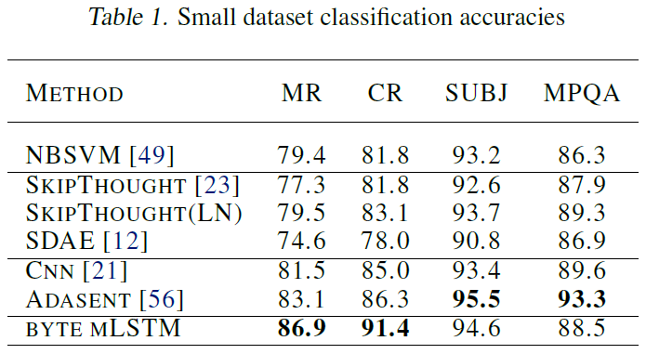
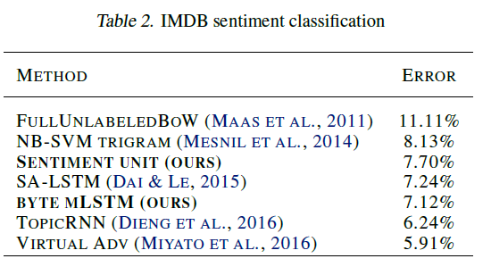
Experiment
Notes:
在多个情感分析的数据集上取得了很好的效果

Slide 7
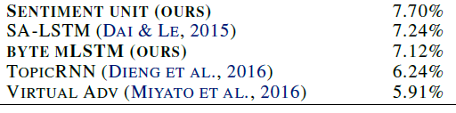
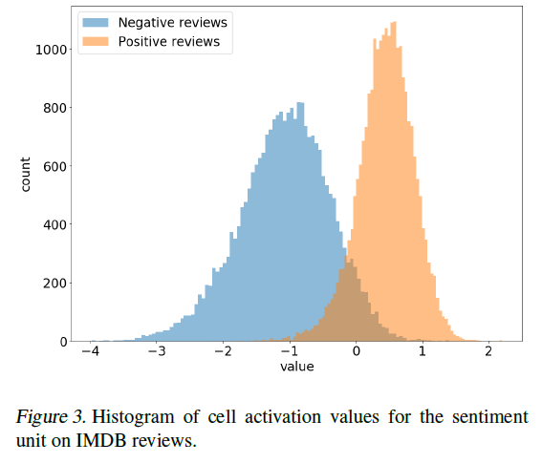
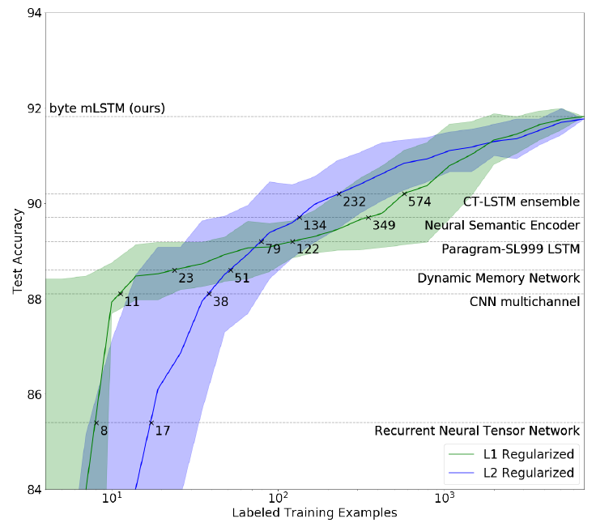
EXPERIMENT
Sentiment unit
Data efficient
Notes:
Stanford Sentiment Treebank数据集：经过了预训练之后，模型对数据的利用效率有了很大的提高，L1-regularized 模型可以仅使用 11 个有标注样本就能实现媲美多通道 CNN（multichannel CNN）的表现，且仅使用 232 个样本就能媲美当前最佳的 CT-LSTM Ensembles
IMDB数据集情感分类：通过L1正则化，作者发现有1个神经元的值和情感极性高度相关，在不同的情感上呈现出双峰分布，对该神经元直接设定一个阈值就可以达到很好的情感分类的效果

Slide 8
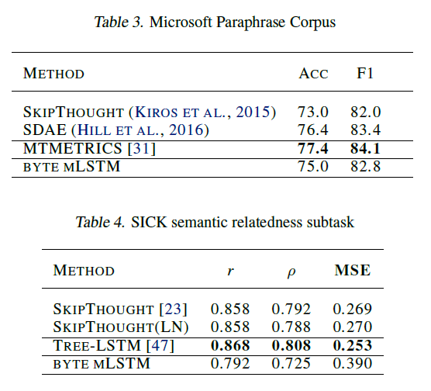
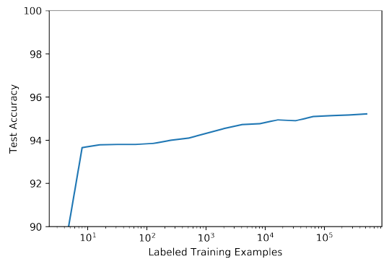
EXPERIMENT
Notes:
为了验证在下游的情感分析子任务上需要多少样本才能达到一个比较好的性能，作者在YELP数据集上做了一个实验，发现在下游情感分析子任务上，10个样本就能得到比较好的结果
作者还实验了其它的任务，效果不是很好，作者认为Microsoft Paraphrase Corpus和SICK数据集的领域和模型预训练语料的领域不一样，所以难以取得较好的效果

Slide 9
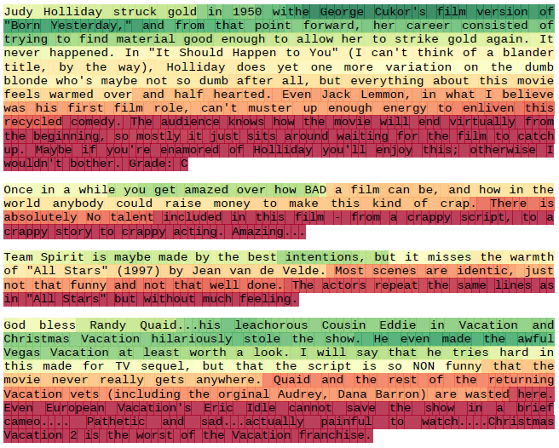
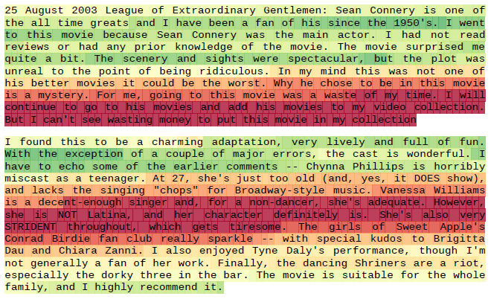
Visialization
Notes:
情感神经元结果的可视化，红色代表消极情感，绿色代表积极情感

Slide 10
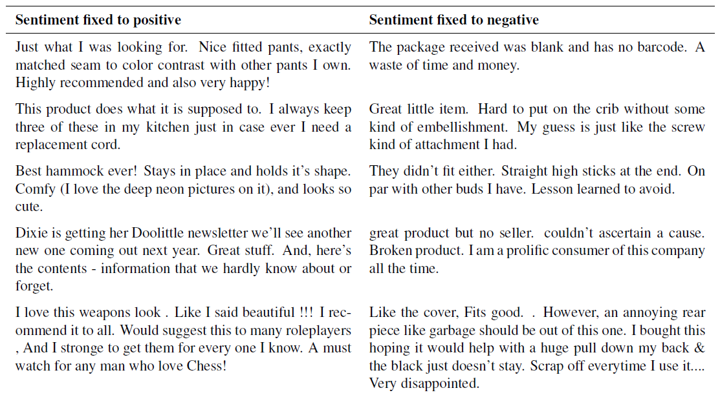
Visiallization
Notes:
通过控制情感神经元的值，可以实现指定情感的条件生成

Slide 11
Conclusion
It is possible that sentiment as a conditioning feature has strong predictive capability for language modelling.
Learned representations are sensitive to data distribution they are trained on.
Language modelling objective is sufficient to learn high-quality representations.
Future work:
More complicated model
Handle domain shift

Slide 12
Universal Language Model Fine-tuning for Text Classification
Author: Jeremy Howard, Sebastian Ruder
Affiliation: fast.ai
Year: 2018

Slide 13
Introduction
Problem: existing approaches in NLP still require task-specific modifications and training from scratch.
Motivation: In light of the benefits of pretraining, we should be able to do better than randomly initializing the remaining parameters of our models.
Challenge: inductive transfer via finetuning has been unsuccessful for NLP. LMs overfit to small datasets and suffered catastrophic forgetting when fine-tuned with a classifier. Compared to CV, NLP models are typically more shallow and thus require different fine-tuning methods.

Slide 14
Contribution
We propose Universal Language Model Fine-tuning (ULMFiT), a method that can be used to achieve CV-like transfer learning for any task for NLP.
Tricks: We propose discriminative fine-tuning, slanted triangular learning rates, and gradual unfreezing, novel techniques to retain previous knowledge and avoid catastrophic forgetting during fine-tuning.
We significantly outperform the state-of-the-art on six representative text classification datasets, with an error reduction of 18-24% on the majority of datasets.
We show that our method enables extremely sample-efficient transfer learning and perform an extensive ablation analysis.
We make the pretrained models and our code available to enable wider adoption.

Slide 15
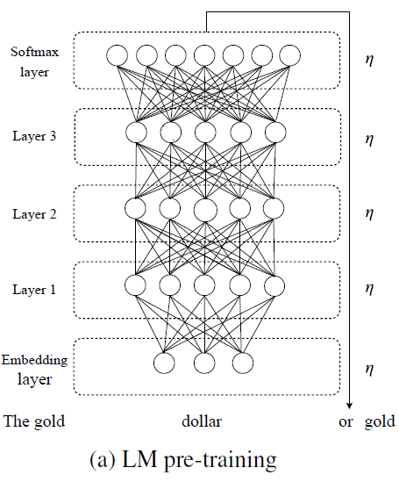
Lm pre-training
Pretraining data size: Wikitext-103 with 1.03*10^8 words.
The LM is trained on a general-domain corpus to capture general features of the language in different layers.

Slide 16
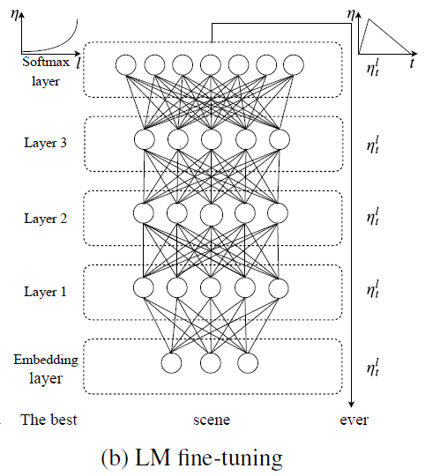
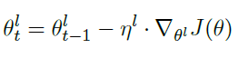
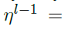
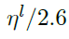
Target task LM fine-tuning
The full LM is fine-tuned on target task data using discriminative fine-tuning (‘Discr’) and slanted triangular learning rates (STLR) to learn task-specific features.
Discriminative fine-tuning: As different layers capture different types of information, they should be fine-tuned to different extents. Discriminative fine-tuning allows us to tune each layer with different learning rates.

Slide 17
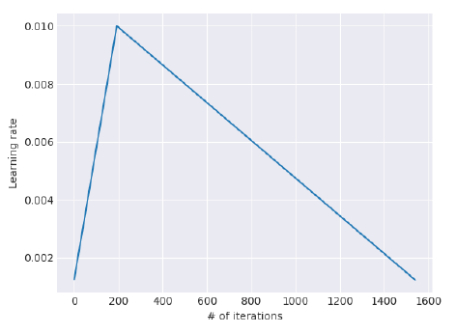
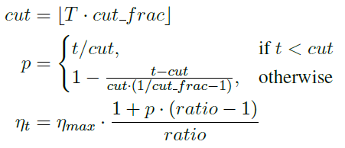
Target task LM fine-tuning
Slanted triangular learning rates: For adapting its parameters to task-specific features, we would like the model to quickly converge to a suitable region of the parameter space in the beginning of training and then refine its parameters.

Slide 18
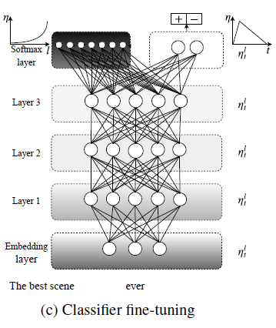
Target task classifier fine-tuning
The classifier is fine-tuned on the target task using gradual unfreezing, ‘Discr’, and STLR to preserve low-level representations and adapt high-level ones
Gradual unfreezing: Rather than fine-tuning all layers at once, which risks catastrophic forgetting, we propose to gradually unfreeze the model starting from the last layer as this contains the least general knowledge. We first unfreeze the last layer and fine-tune all unfrozen layers for one epoch. We then unfreeze the next lower frozen layer and repeat, until we finetune all layers until convergence at the last iteration.

Slide 19
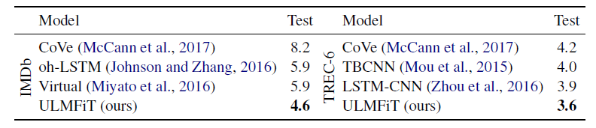
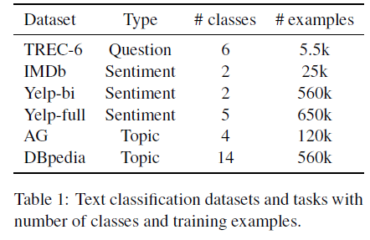
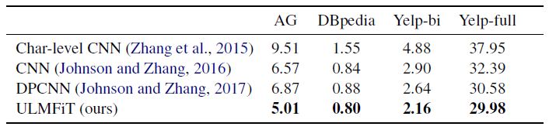
EXPERIMENT
Notes:
注意TREC-6语料规模非常小
在几个预料上取得了state-of-art

Slide 20
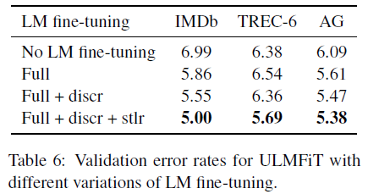
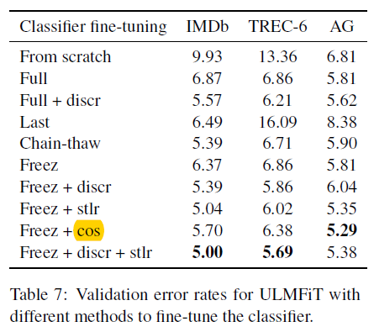
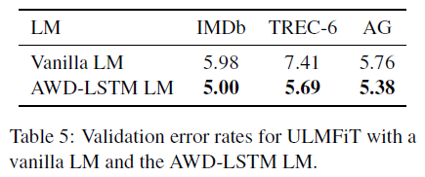
Ablation Study
Notes:
更好的语言模型，在下游任务上进行LM fine-tuning，以及使用作者提出的方法进行微调都能够获得更好的效果

Slide 21
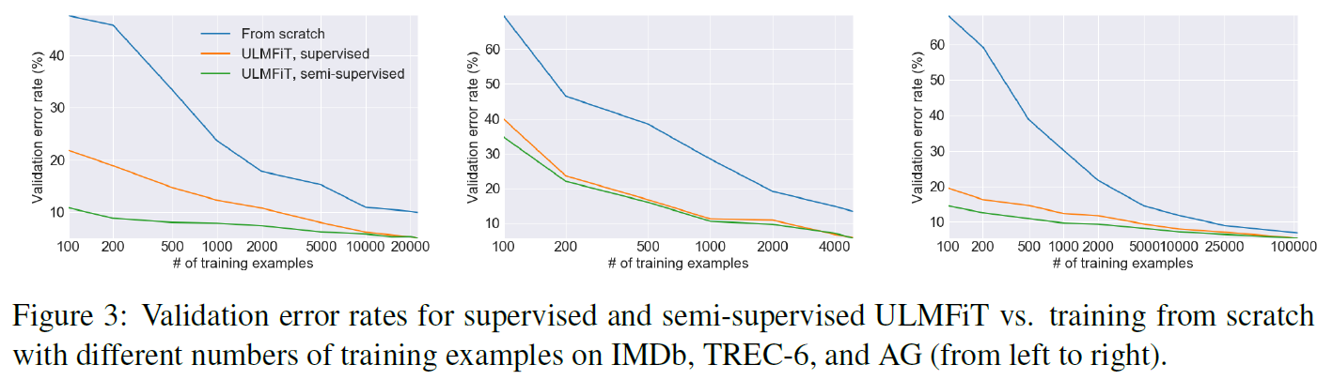
Data Efficiency
Supervised: only labeled examples are used for LM fine-tuning.
Semi-supervised: all task data is available and can be used to fine-tune the LM(including unlabeled data on downstream task).
From scratch
Notes:
预训练能够让模型利用少量的语料也能取得很好的效果

Slide 22
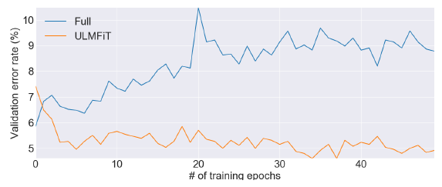
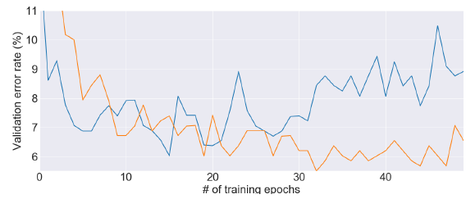
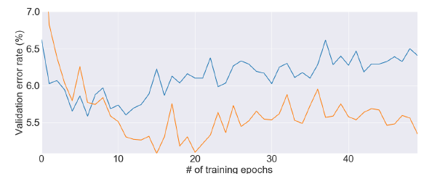
Robust
IMDb
TREC-6
AG
Notes:
微调过程中验证集误差，蓝色代表直接微调，黄色代表使用作者提出的方法进行微调

Slide 23
Conclusion
Compared with Radford et al. , ULMFiT is pretrained on open-domain corpus rather than e-commerce review domain corpus.
We have proposed ULMFiT, an effective and extremely sample-efficient transfer learning method that can be applied to any NLP task.
We have also proposed several novel fine-tuning techniques that in conjunction prevent catastrophic forgetting and enable robust learning across a diverse range of tasks.
Our method significantly outperformed existing transfer learning techniques and the stateof- the-art on six representative text classification tasks.

Slide 24
Future work
NLP for non-English languages, where training data for supervised pretraining tasks is scarce.
New NLP tasks where no state-of-the-art architecture exists.
Tasks with limited amounts of labeled data.
Improve language model pretraining and fine-tuning and make them more scalable.
Language modeling can also be augmented with additional tasks in a multi-task learning fashion or enriched with additional supervision.
An extension to sequence labeling is straightforward, other tasks with more complex interactions such as entailment or question answering may require novel ways to pretrain and fine-tune.
More studies are required to better understand what knowledge a pretrained language model captures, how this changes during fine-tuning, and what information different tasks require.

Slide 25
Improving Language Understanding by Generative Pre-Training
Affiliation: OpenAI
Year: 2018

Slide 26
Introduction
Problem: The ability to learn effectively from raw text is crucial to alleviating the dependence on supervised learning in natural language processing.
Challenge: Leveraging more than word-level information from unlabeled text, however, is challenging for two main reasons.
It is unclear what type of optimization objectives are most effective at learning text representations that are useful for transfer.
There is no consensus on the most effective way to transfer these learned representations to the target task.

Slide 27
Contribution
We demonstrate that large gains on these tasks can be realized by generative pre-training of a language model on a diverse corpus of unlabeled text, followed by discriminative fine-tuning on each specific task.
In contrast to previous approaches, we make use of task-aware input transformations during fine-tuning to achieve effective transfer while requiring minimal changes to the model architecture.
We demonstrate the effectiveness of our approach on a wide range of benchmarks for natural language understanding.

Slide 28
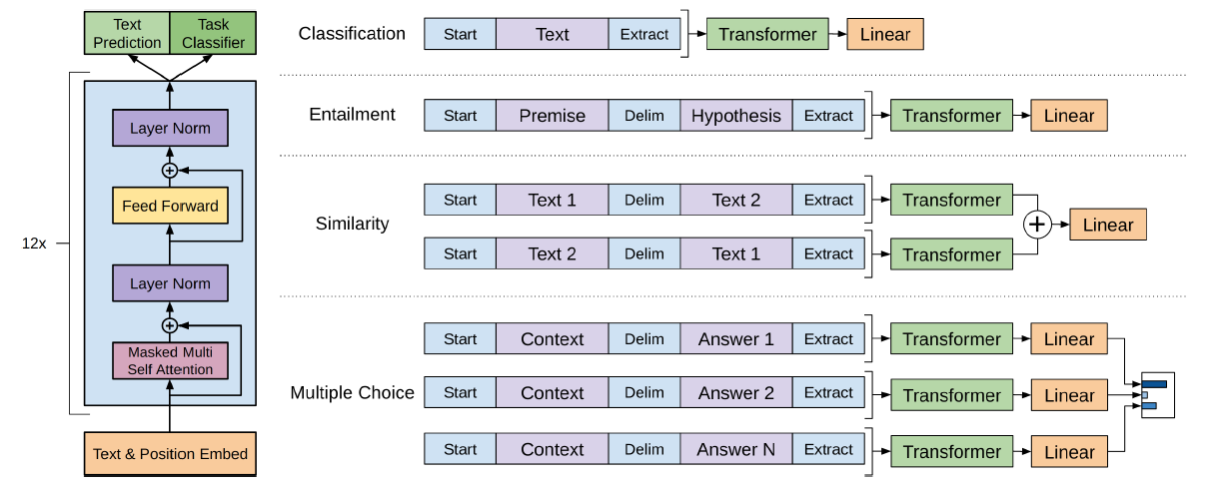
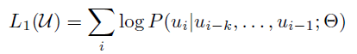
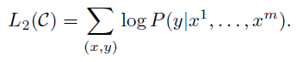
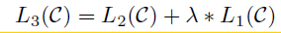
method
Unsupervised pre-training Speed: Titan Xp*8*30 days.
Supervised fine-tuning: Overall, the only extra parameters we require during fine-tuning are Linear layer and embeddings for delimiter tokens.
Supervised fine-tuning objective combining LM and classification:
Notes:
首先使用Transformer训练一个语言模型，然后在语言模型上加入一个线性层，然后只微调这个线性层和任务相关的分隔符的参数

Slide 29
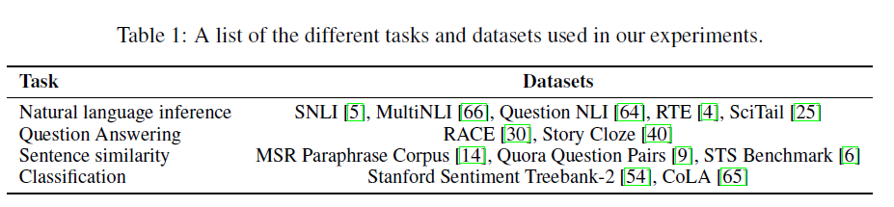
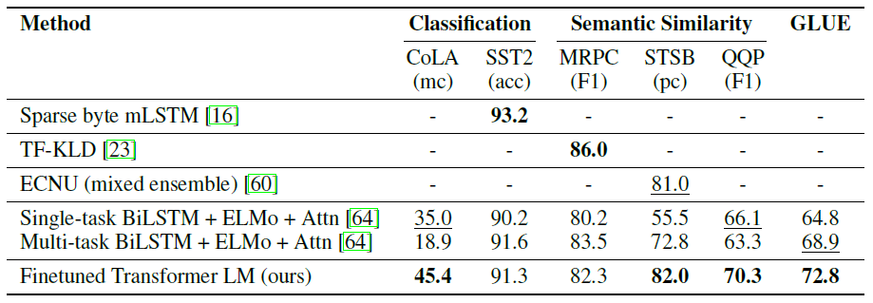
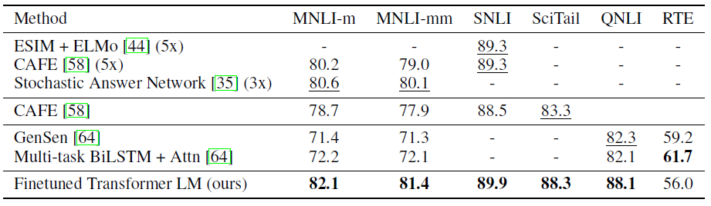
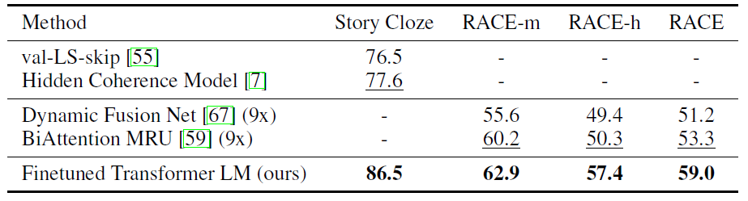
Experiment

Slide 30
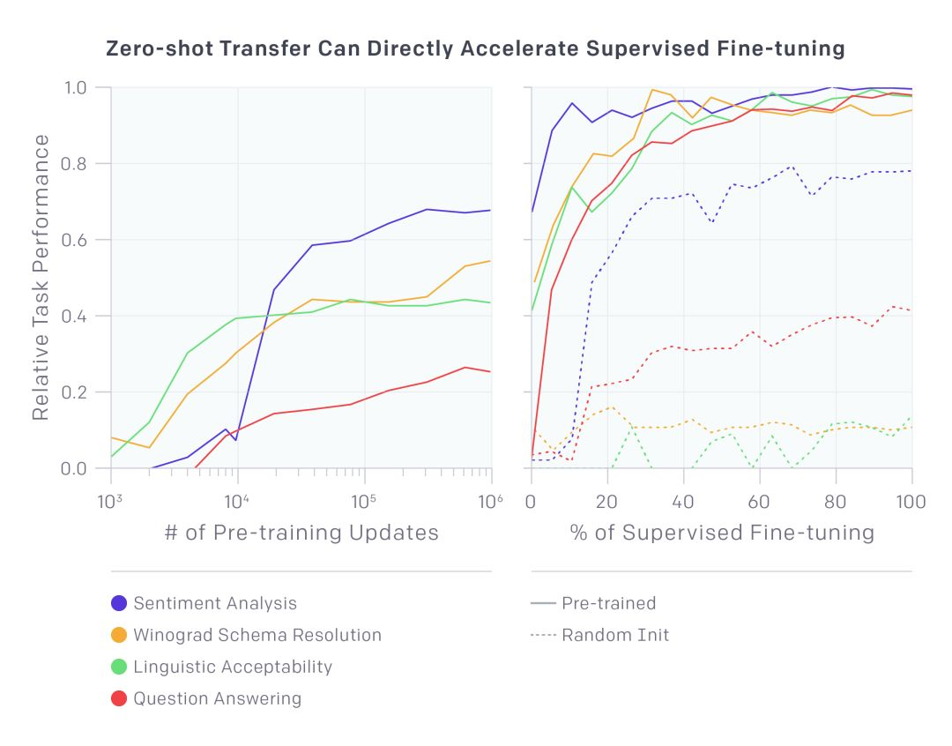
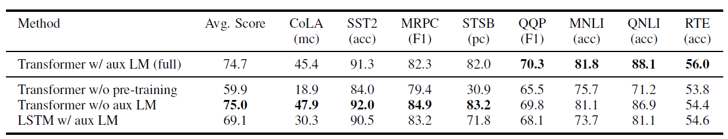
Experiment
Notes:
预训练的步数越多，效果越好，并且预训练能够在少量样本时表现相比没有预训练时更好

Slide 31
conclusion
We introduced a framework for achieving strong natural language understanding with a single task-agnostic model through generative pre-training and discriminative fine-tuning.
Our work suggests that achieving significant performance gains is indeed possible, and offers hints as to what models (Transformers) and data sets (text with long range dependencies) work best with this approach.
Future work:
Scaling the approach: There is significant room for improvement using the well-validated approach of more compute and data
Improved fine-tuning using approach explored in ULMFiT
Better understanding of why generative pre-training helps: broader context VS improved world knowledge

Slide 32
Deep contextualized word representations
Affiliation: Allen Institute for Artificial Intelligence, Paul G. Allen School of Computer Science, Engineering, University of Washington
Year: 2018

Slide 33
Introduction
Problem: Previous language embeddings(Word2Vec, GloVe, fastText) are context-insensitive.
Example:
Chris attended the play at the Shaw Festival.
Chris didn’t want to play bridge.
Motivation: Augmenting the word in question with the context in which it appears.
Contribution:
ELMo models both (1) complex characteristics of word use (e.g., syntax and semantics), and (2) how these uses vary across linguistic contexts (i.e., to model polysemy).
ELMo can be easily added to existing models and significantly improve the state of the art across six challenging NLP problems.
Exposing the deep internals of the pre-trained network is crucial, allowing downstream models to mix different types of semi-supervision signals.
Notes:
第一个play是表演，是名词，第二个play是玩，是动词

Slide 34
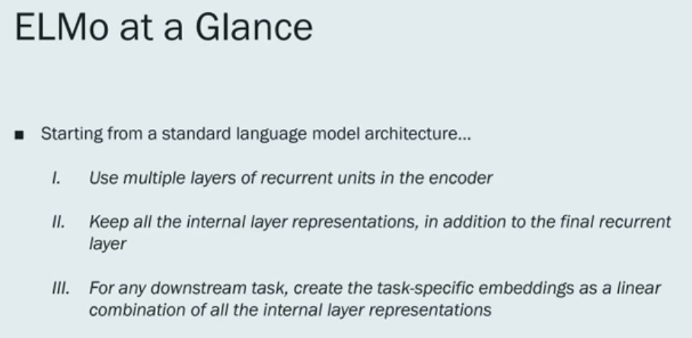
Method
Notes:
ELMo的想法起源于语言模型，相比于传统的语言模型，ELMo做了上面的改进

Slide 35
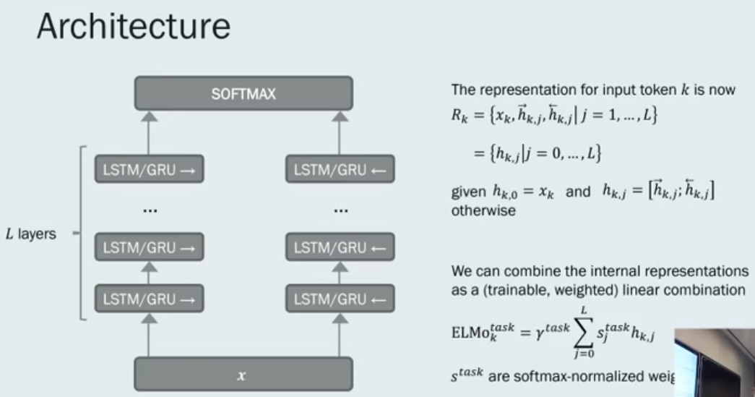
METHOD
Notes:
1.首先在一个大的语料库上训练语言模型
2.在特定的任务上学习$γ^{task}$和$s_{j}^{task}$，对预训练的语言模型中个各层进行加权求和
Note：每个词使用CharCNN得到一个词的表示，可以更好的克服OOV的问题

Slide 36
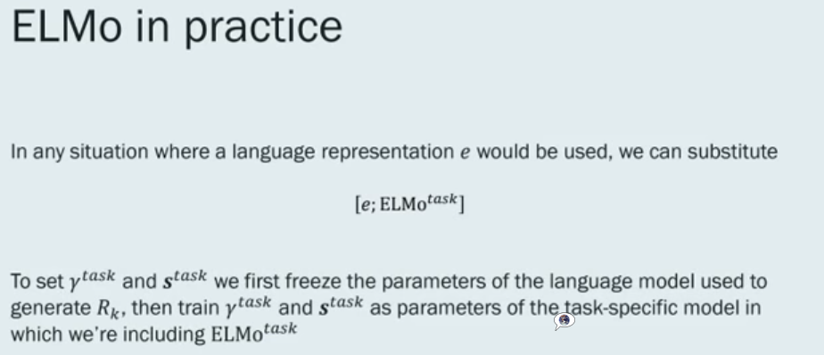
APPLY EMLo in downstream task

Slide 37
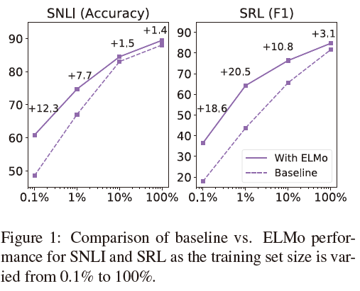
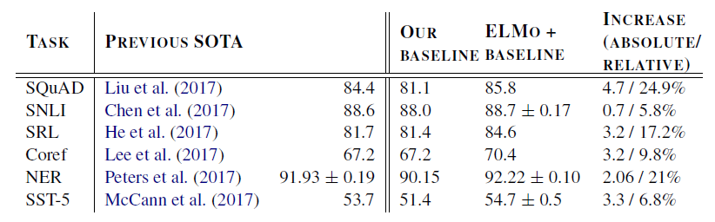
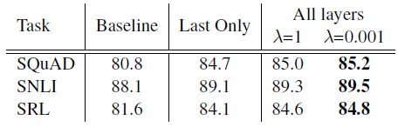
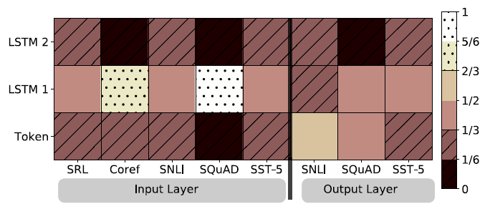
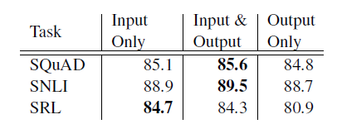
Experiment & Ablation study
Notes:
$λ$越大，考虑的语言模型的顶层表示越多，$λ$越小，考虑语言模型的全局信息越多
ELMo插入到输入层或者encoding的输出层

Slide 38
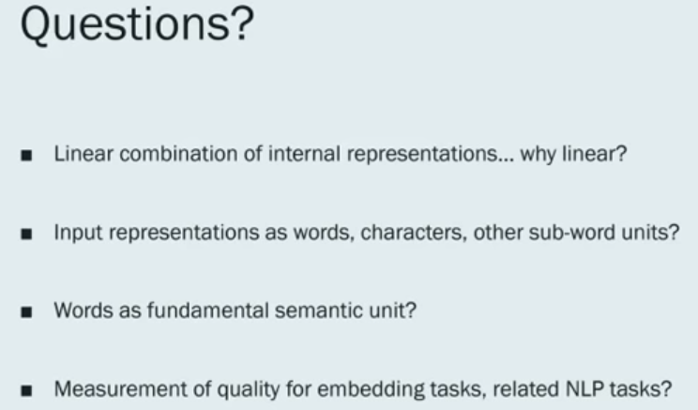
conclusion
We have shown large improvements when applying ELMo to a broad range of NLP tasks.
biLM layers efficiently encode different types of syntactic and semantic information about wordsin- context, and that using all layers improves overall task performance.

Slide 39
BERT: Pre-training of Deep Bidirectional Transformers for Language Understanding
Affiliation: Google AI Language
Year: 2018

Slide 40
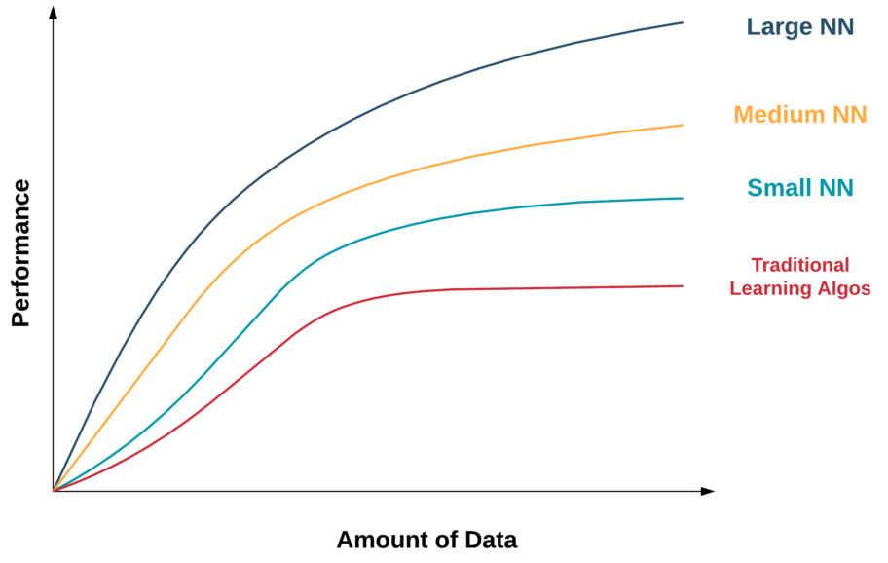
Introduction
Supervised learning is at the core of most of the recent success of machine learning. However, it can require large, carefully cleaned, and expensive to create datasets to work well.
Unsupervised learning removes the bottleneck of explicit human labeling and scales well with current trends of increasing compute and availability of raw data.
How to further language capabilities by using unsupervised learning to augment systems with large amounts of unlabeled data?
Language model fine-tuning!

Slide 41

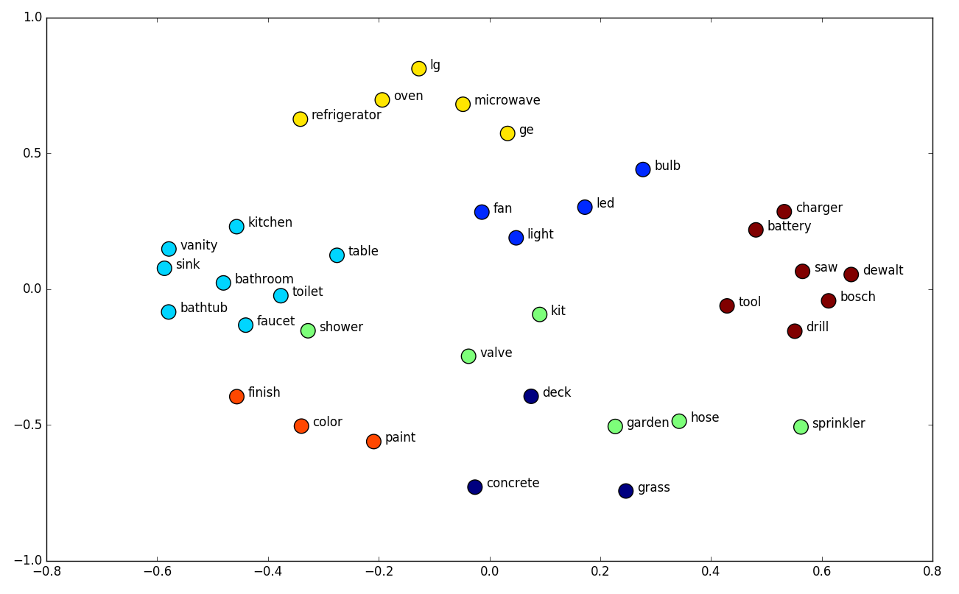
RELATED WORK
Feature-based Approaches
Word embedding: pretrained word embeddings are considered to be an integral part of modern NLP systems, offering significant improvements over embeddings learned from scratch.
Sentence embeddings/paragraph embeddings: learned representations are also typically used as features in a downstream model.
ELMo: context sensitive features from a language model.

Slide 42
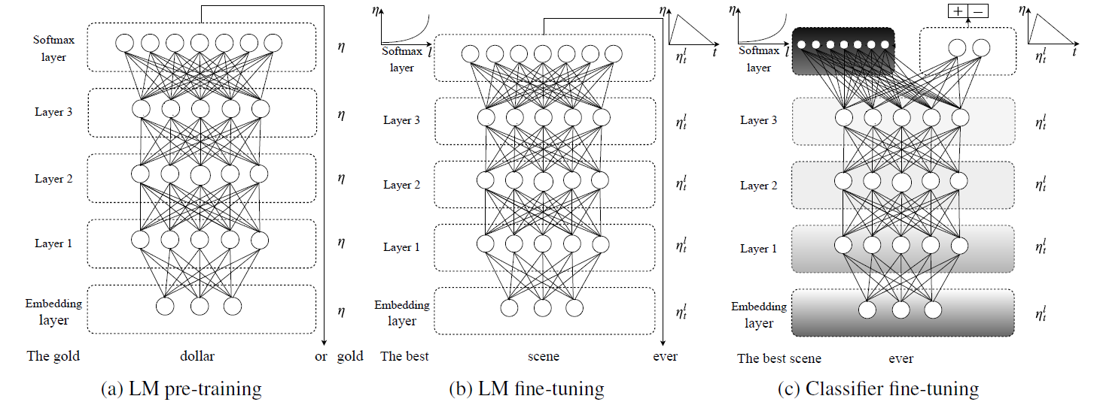

RELATED WORK
Fine-tuning Approaches
ULMFiT: fine-tuning a language model, then apply it to any task in NLP.
OpenAI GPT: fine-tuning pre-training Transformer-LM with task specific layer.
Transfer Learning from Supervised Data
Popular in computer vision research.
Limited use in NLP because of need of abundant data.

Slide 43


MEthod
Built on Transformer block
Input Representation
WordPiece(subword) embeddings
Positional embeddings
Classification embedding
Sentence pairs
Pre-training Tasks
Task #1: Masked LM
Learning token-level features
[MASK] token: my dog is hairy -> my dog is [MASK]
Random word: my dog is hairy -> my dog is apple
Unchanged: my dog is hairy -> my dog is hairy.
Task #2: Next Sentence Prediction
Learning sentence-level features

Slide 44

Difference
BERT uses a bidirectional Transformer.
OpenAI GPT uses a left-to-right Transformer.
ELMo uses the concatenation of independently trained left-to-right and right-to-left LSTM to generate features for downstream tasks.
Pros: BERT representations are jointly conditioned on both left and right context in all layers

Slide 45

FINE-tuning
Sequence-level tasks: taking the final hidden state for the [CLS] token as output layer’s input.
Span-level tasks: adding start token and end token, then computing maximum scoring span.
Token-level tasks: adopting hidden state of every word to predict tagging label.

Slide 46


EXamples
SQuAD v1.1
SWAG

Slide 47


EXamples
Named Entity Recognition
MNLI

Slide 48


Examples…
QQP
SST-2

Slide 49




Experiment(State of art)
SWAG
SQuAD
Named Entity Recognition: CoNLL-2003
Notes:
BERT在各种任务上都超过了之前state of art 的结果，并且在部分任务上超过了人类

Slide 50




Ablation Study
Effect of Model Size
Effect of Pre-training Tasks
Feature-based Approach with BERT
Effect of Number of Training Steps
Notes:
1.No NSP代表只用Task 1训练，LTR & No NSP代表使用传统的Left-to-Right (LTR) LM训练，+BiLSTM使用LTR & No NSP的特征和双向的LSTM来进行fine-tuning
2.LM的困惑度和下游任务的表现有很强的相关性，并且对于MRPC这种只有3600条标记数据的语料来说，BERT也得到了非常好的效果
3.无监督的语言模型训练的步数越多，下游任务效果越好
4.通过BERT中各层学习到的特征，不通过fine-tuning就能在下游任务中取得较好的效果

Slide 51
Conclusion
Rich, unsupervised pre-training is an integral part of many language understanding systems.
Unsupervised pre-training enables even low-resource tasks to benefit from very deep architectures.
BERT can tackle a broad set of NLP tasks.
Future work: investigating the linguistic phenomena that may or may not be captured by BERT.

Slide 52

Conclusion

